Slide 1
Why DO Data WareHousing
& Business Intelligence go hand in hand?

Slide 2

Objective
At the end of this module, you will be able to Know :
What is Data Warehousing & Business Intelligence ?
What is Data Warehousing Architecture ?
What is Data Modelling / Introduction to ER Win r9 Tool ?
What is ETL / An Open Source ETL Tool – Talend 5.x ?
What is Business Intelligence / An Open Source Tableau Public 9.x ?

Slide 3
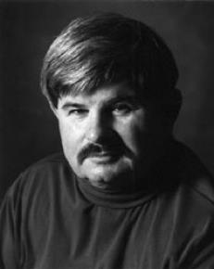
What is Data Warehouse
Loosely Speaking
A data warehouse refers to a database that is maintained separately from an organization’s operational database
“A data warehouse is a subject-oriented, integrated, time-variant, and nonvolatile collection of data in support of management’s decision-making process.”
Officially Speaking
W.H. Inmon

Slide 4
Data Warehouse Properties
Subject Oriented
Integrated
Data Warehousing
Non Volatile
Time Variant

Slide 5
Subject-Oriented
Data is categorized and stored by business subject rather than by application
OLTP Applications
Data Warehouse Subject
Equity
Plans
Shares
Customer
financial
information
Insurance
Savings
Loans

Slide 6
Integrated
Data on a given subject is defined and stored once.
Savings
Current
accounts
Customer
Loans
OLTP Applications
Data Warehouse

Slide 7
Time-Variant
Data is stored as a series of snapshots, each representing a period of time…
TIME | DATA
Jan-97 | January
Feb-97 | February
Mar-97 | March
Jan-97 | January

Slide 8
Non-Volatile
Typically data in the data warehouse is not updated or deleted.
Operational
Warehouse
Load
Insert Update Delete
Read
Read

Slide 9
Changing Data
First time load
Refresh
Refresh
Operational Database
Warehouse Database

Slide 10

What is Data Warehouse
Officially Speaking
“Data warehouse is the conglomerate of all data marts within the enterprise. Information is always stored in the dimensional model.”
Ralph Kimball

Slide 11
Inmon Vs Ralph Kimball
Characteristics | Inmon | Kimball
Business Decision Support Requirements | Strategic | Tactical
Data Integration Requirement | Enterprise Wise Integrator | Individual Business Requirement
Data Structure Requirement | Data that meet multiple and varied information needs and non-metric data | KPI, Business Performance Measure & Scorecards Requirements
Persistency of Data in Source System | Source Systems have high rate of change | Source Systems are quite stable
Skill Sets | Bigger Team of Specialists | Small Team of Generalists
Time Constraint | Longer Time Required | Urgent delivery as this is subjective
Cost to Build | High Start-up Costs | Low Start-Up Costs

Slide 12
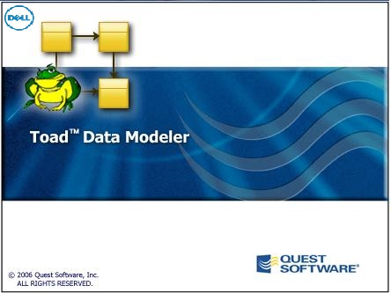
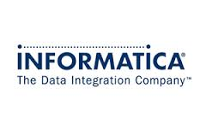



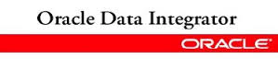
Data Ware Housing Products
Entity Relationship / Schema Modeling
Data Integration / ETL

Slide 13
What is Business Intelligence?
Business intelligence (BI) is the set of techniques and tools for the transformation of raw / production and operational data into meaningful and useful information for business analysis purposes for various level.
Business intelligence (BI) talks about how traditional data which transform into the BI which have multiple initiatives to measure, manage, and improve on the performance of individuals, processes, teams, and business units for the specific business area.
During the operation of business, the following questions must be asked. The functions of monitoring, analyzing, and planning delve into these questions as follows :
What has happened?
What is happening?
Why?
What will happen?
What do we want to have happen?

Slide 14
What is Business Intelligence Categories?
Strategic Business Intelligence: Management collaborates and agrees on a strategy and a method in which they would like to see information presented, for example, in maps, scorecards, reports, or dashboards.
Now that you have your strategy defined, it is imperative that you do something with the data that you have collected
Analytical Business Intelligence: Once Strategic BI sets the foundation in the form of key performance metrics, then Analytical BI is employed to identify the source of an issue once it has been uncovered.
Tools like analytic dashboards, OLAP, predictive analytics, and ad hoc queries are utilized to determine the location or the cause of a major problem.

Slide 15
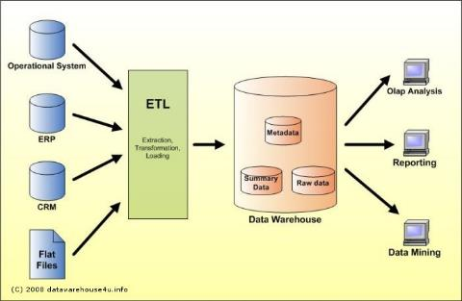
Data Ware House Architecture

Slide 16


- CA ERwin Introduction
ERwin is a popular data modeling tool used by a number of major companies throughout the world. The product is currently owned, developed, and marketed by Computer Associates, a leading software company.
The product supports a variety of aspects of database design, including data modeling, forward engineering (the creation of a database schema and physical database on the basis of a data model), and reverse engineering (the creation of a data model on the basis of an existing database) for a wide variety of relational DBMS, including Microsoft Access, Oracle, DB2, Sybase, and others.

Slide 17
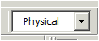
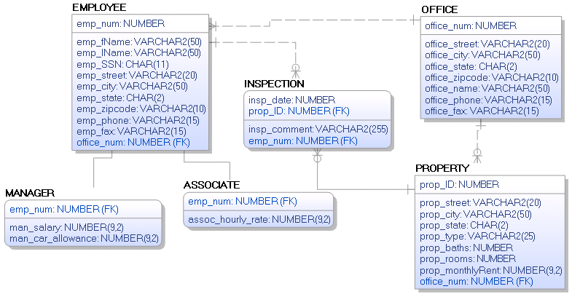
Physical ER Diagram

Slide 18
Open Source VS Commercial ETL Tools
Open Source ETL | Commercial ETL
License Details
Licensing Model | Open-Core Model. No charges for extra CPU cycles | Core Model. Extra usage charges can be applied for over-the-limit CPU cycles
Licensing Channel | via GNU public license/Apache license | Vendor specific
Cost Differentiation
License Costs | 30-60% < 1X times Commercial license (Mostly) | 1X times
Support and Maintenance Costs | Close to Commercial vendor costs (Mostly) | Close to Open-Source
Advanced Features | Offered through "Commercial" Open-Source | Add-ons
Type of Support and Maintenance | Tiered pricing model. E.g. Community(Free, Forums), Silver, Gold and Platinum Editions | Not offered in tiers (Mostly). Add-on to licensing costs

Slide 19

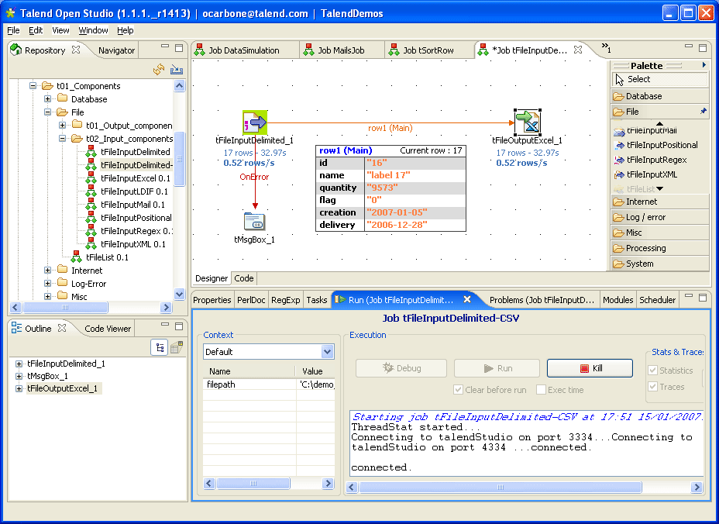
Talend Open DI Studio 5.x - Overview
Talend Open Studio for Data Integration operates as a code generator, producing data-transformation scripts and underlying programs in Java. Its GUI gives access to a metadata repository and to a graphical designer. The metadata repository contains the definitions and configuration for each job - but not the actual data being transformed or moved. All of the components of Talend Open Studio for Data Integration use the information in the metadata repository.
The product is based on Eclipse.
Talend Open DI Studio typically use for:
synchronization or replication of databases
right-time or batch exchanges of data
ETL (Extract/Transform/Load) for analytics
data migration
complex data transformation and loading
data quality exercises
big data
Talend Open Studio for Data Integration primarily differs from Talend Enterprise Data Integration in that the Enterprise version has a Subversion plug-in built in, as well as support for joblets. Using Talend Enterprise Data Integration, ETL and ELT jobs can have a dynamic schema.

Slide 20
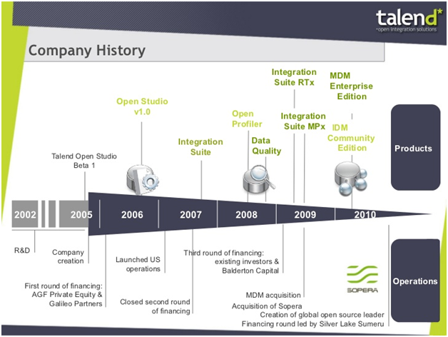
Talend - History

Slide 21
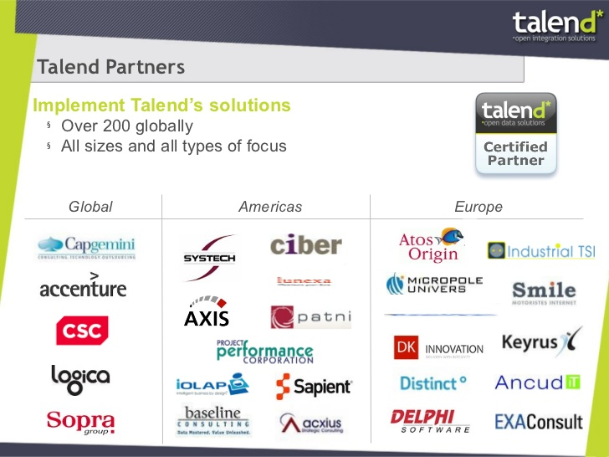
Talend - Partners

Slide 22
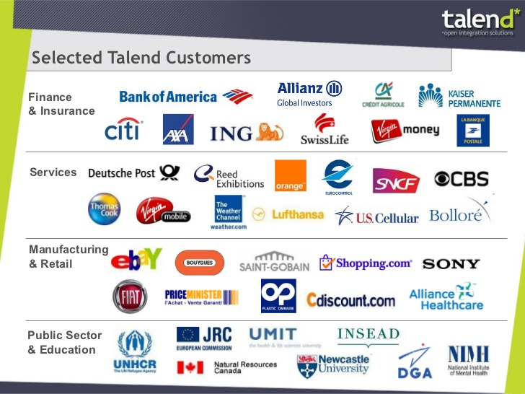
Talend - Customers

Slide 23
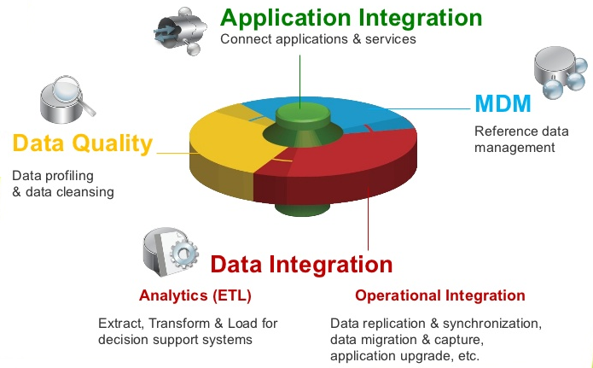
Talend - Market Position

Slide 24
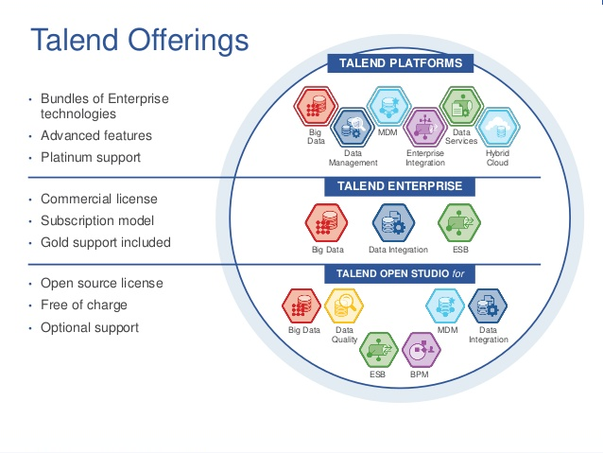
Talend - Product Offering

Slide 25
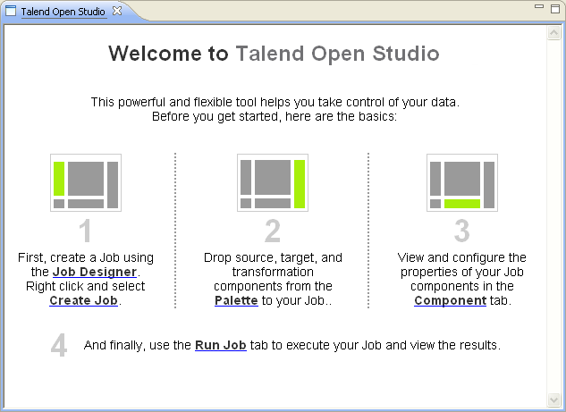
Talend DI Studio - Welcome Page

Slide 26

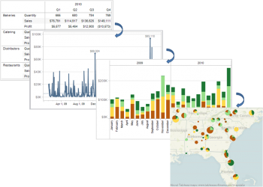
Data visualization With Tableau
Data visualization tools allow anyone to organize and present information intuitively. This is becoming more vital as data proliferates in every field from bar codes in retail stores to player behavior in online games.
All of this data is meaningless without a way to organize and present important findings within it. People comprehend data better through pictures than by reading numbers in rows and columns.
So by visualizing data, you are able to more effectively ask and answer important questions such as “Where are sales growing,” “What is driving growth” and “What are the characteristics of my customers using different services?” By using Tableau visualizations, you gain the ability to quickly answer questions; your data becomes a competitive advantage instead of an underutilized asset.

Slide 27
Tableau Software, Inc.
Company and Leadership
The company was founded in Mountain View, California in January, 2003 by Chris Stolte, Christian Chabot and Pat Hanrahan.
Based on a breakthrough from Stanford University, Tableau makes visual analytics and business intelligence software that delivers:
10-100X productivity improvements
amazing multi-dimensional discoveries
web analytics at 1/10th the cost of a “BI Platform”
The company is headquartered in Seattle, WA.
Customers
Google
Allstate
Cornell
Harvard
Apple
NSA
Microsoft
1,000’s more
Key Partners
Oracle OEM
Microsoft Gold Certified
Teradata Partner

Slide 28
Customers: 4,000 Strong Companies

Slide 29
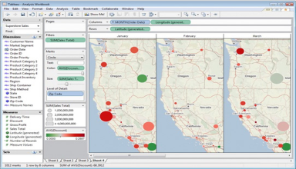
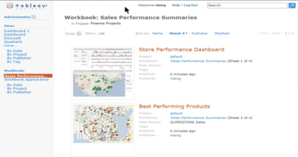
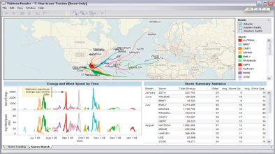
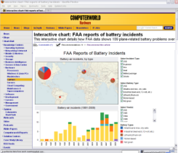
Tableau Products
Tableau Desktop
Create
Tableau Server
Share - Web
Tableau Reader
Share - Local
Tableau Public
Share - Everyone
ad hoc analytics, dashboards, reports, graphs
explore, visualize, and analyze your data
create dashboards to consolidate multiple views
deliver interactive data experiences
business intelligence solution scales to organizations of all sizes
share visual analytics with anyone with a web browser
publish interactive analytics or dashboards
secure information and manage metadata
collaborate with others
share visualizations & dashboards on the desktop
filter, sort, and page through the views
“Acrobat for Data”
free download
create and publish interactive visualizations and dashboards
embed in websites and blogs
free download and free hosting service

Slide 30
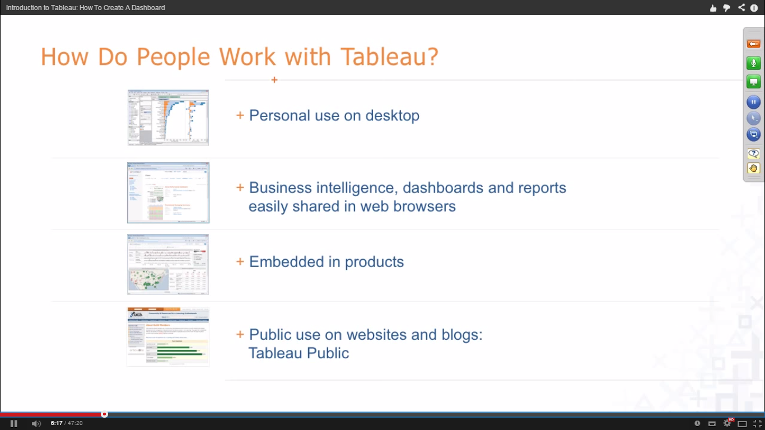
How Do People Work With Tableau

Slide 31
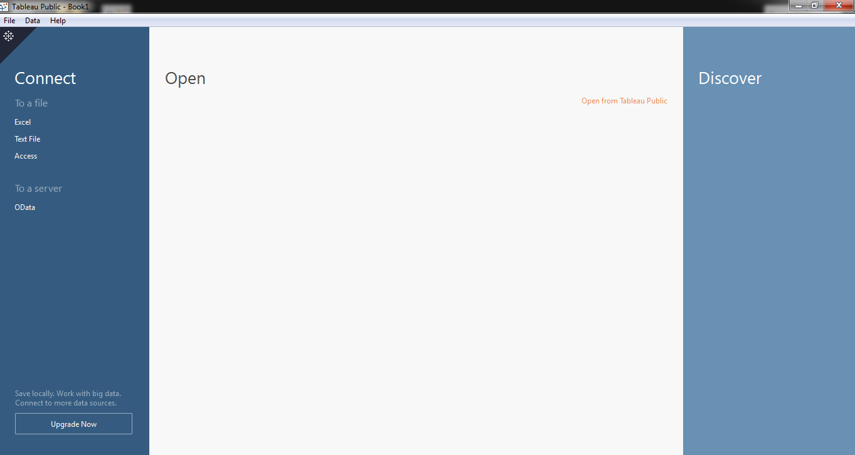
Tableau Public - Start Page

